Slide 1
CIS 519 Recitation
11/15/18

Slide 2
Adaboost
Given weak learners, can we turn them into strong learners?
Adaboost works in iterations and assigns weights to training examples
In each iteration, it updates the weights such that in the next round, the classifier is forced to pay attention to the incorrectly classified examples
The final classifier is a combination of all the weak classifiers learnt

Slide 3
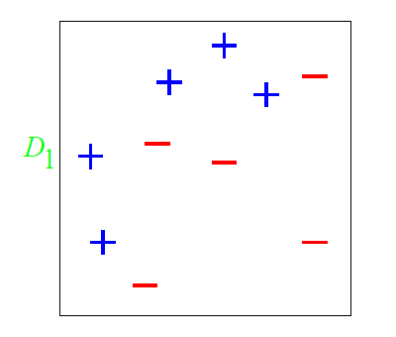
A Toy Example

Slide 4
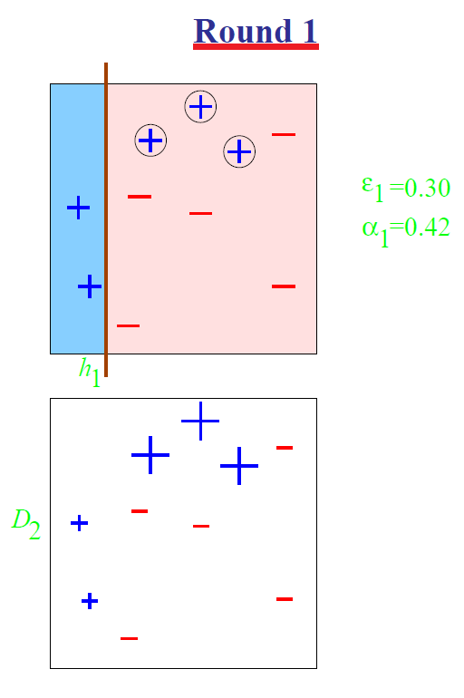
4

Slide 5
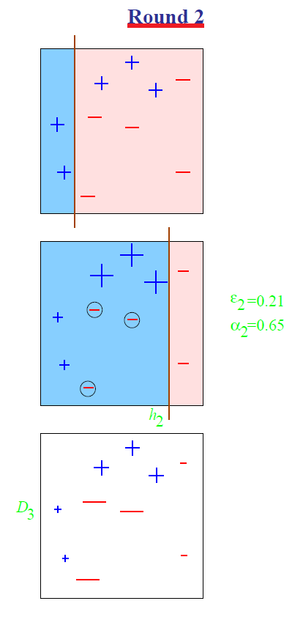

Slide 6
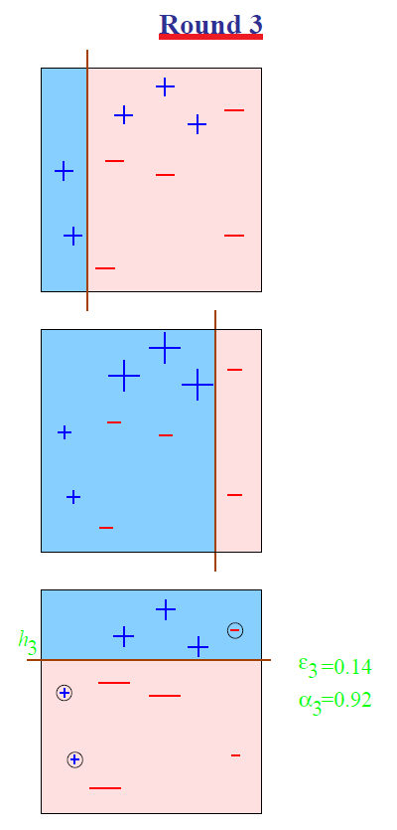

Slide 7
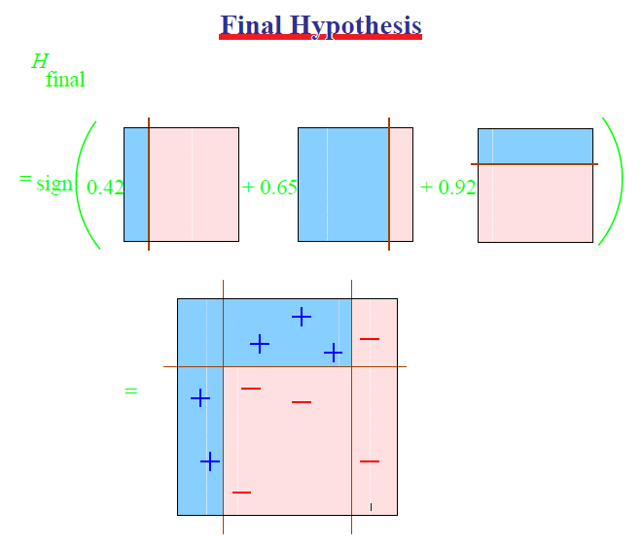
7

Slide 8
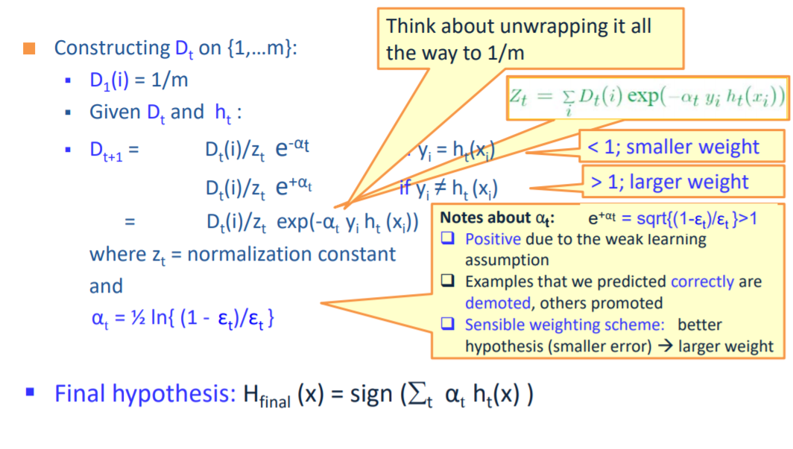
AdaBoost

Slide 9
Linear Classification
Although both classifiers separate the data, the distance with which the separation is achieved is different:
h₁
h₂
9

Slide 10
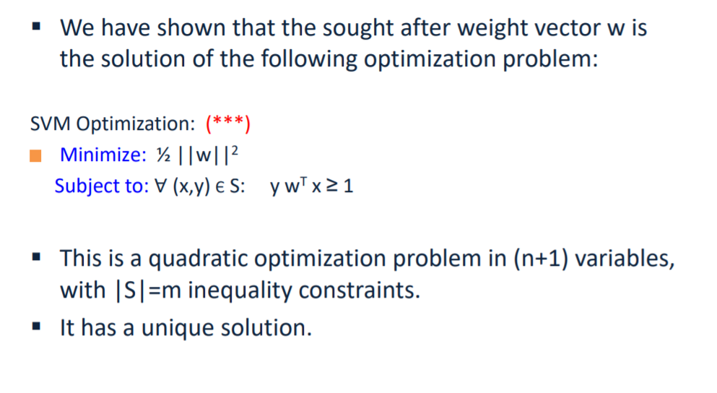
Hard SVM

Slide 11
We get a better classifier on the right with a wider margin by allowing just one mistake

Slide 12
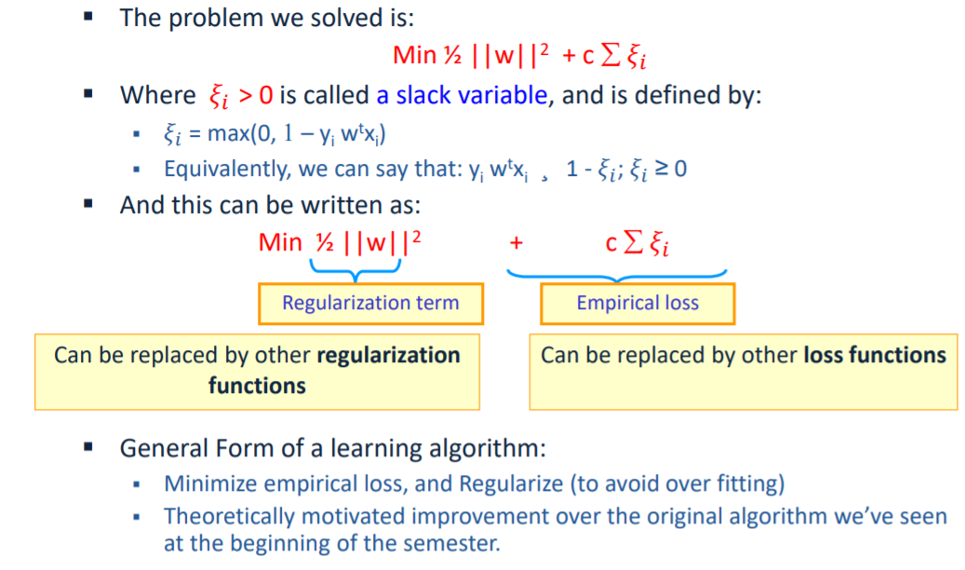
Soft SVM

Slide 13
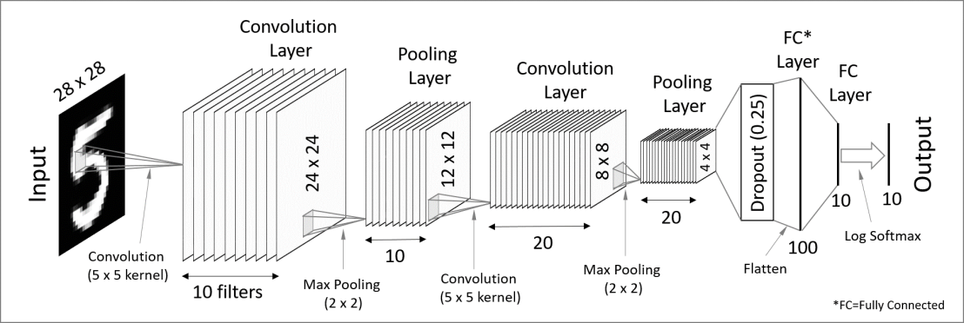
Convolutional Neural Networks

Slide 14
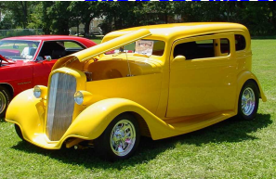
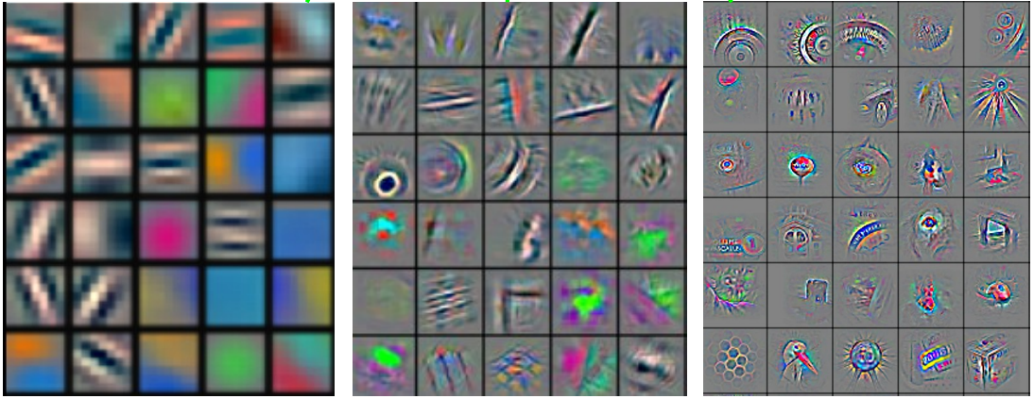
Stage 1
Stage 2
Stage 3
Fully Connected Layer
Input Image
Class Label
Feature visualization of convolutional net trained on ImageNet from [Zeiler & Fergus 2013]

